Slide 1
The Energy Frontier: Tevatron⇒LHC ⇒ ??
Eric Prebys
Fermi National Accelerator Laboratory
Director, US LHC Accelerator Research Program (LARP)

Slide 2
Outline
Motivation
A brief history of the energy frontier
Superconductivity: an enabling technology
Fermilab Tevatron
CERN LHC
The future
Crazy stuff (if time permits)

Slide 3

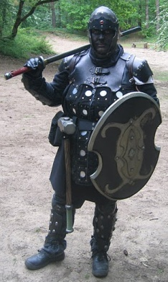
A Word about LARP
The US LHC Accelerator Research Program (LARP) coordinates US R&D related to the LHC accelerator and injector chain at Fermilab, Brookhaven, SLAC, and Berkeley (with a little at J-Lab and UT Austin)
LARP has contributed to the initial operation of the LHC, but much of the program is focused on future upgrades.
The program is currently funded at a level of about $12-13M/year, divided among:
Accelerator research
Magnet research
Programmatic activities, including support for personnel at CERN
(I’m not going to say much specifically about LARP in this talk)
NOT to be confused with this “LARP” (Live-Action Role Play), which has led to some interesting emails
“Dark Raven”

Slide 4
Goal: It’s all about energy and collision rate
To probe smaller scales, we must go to higher energy
To discover new particles, we need enough energy available to create them
The Higgs particle, the last piece of the Standard Model probably has a mass of about 150 GeV, just at the limit of the Fermilab Tevatron
Many theories beyond the Standard Model, such as SuperSymmetry, predict a “zoo” of particles in the range of a few hundred GeV to a few TeV
Of course, we also hope for surprises.
The rarer a process is, the more collisions (luminosity) we need to observe it.
~size of proton

Slide 5
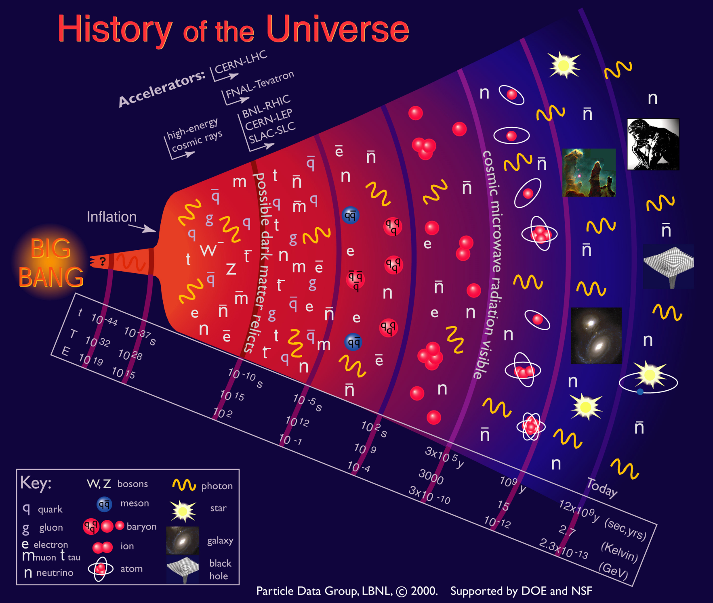
We’re currently probing down to a few picoseconds after the Big Bang

Slide 6
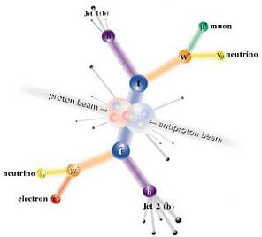
Electrons (leptons) vs. Protons (hadrons)
Electrons are point-like
Well-defined initial state
Full energy available to interaction
Can calculate from first principles
Can use energy/momentum conservation to find “invisible” particles.
Protons are made of quarks and gluons
Interaction take place between these consituents.
At high energies, virtual “sea” particles dominate
Only a small fraction of energy available, not well-defined.
Rest of particle fragments -> big mess!
So why don’t we stick to electrons??

Slide 7
Synchrotron Radiation: a Blessing and a Curse
As the trajectory of a charged particle is deflected, it emits “synchrotron radiation”
Radius of curvature
An electron will radiate about 10¹³ times more power than a proton of the same energy!!!!
Protons: Synchrotron radiation does not affect kinematics very much
Electrons: Beyond a few MeV, synchrotron radiation becomes very important, and by a few GeV, it dominates kinematics - Good Effects: - Naturally “cools” beam in all dimensions - Basis for light sources, FEL’s, etc. - Bad Effects: - Beam pipe heating - Exacerbates beam-beam effects - Energy loss ultimately limits circular accelerators

Slide 8
Practical Consequences of Synchrotron Radiation
Proton accelerators
Synchrotron radiation not an issue to first order
Energy limited by the maximum feasible size and magnetic field.
Electron accelerators
To keep power loss constant, radius must go up as the square of the energy (B∝1/E ⇒ weak magnets, BIG rings):
The LHC tunnel was built for LEP, and e⁺e⁻ collider which used the 27 km tunnel to contain 100 GeV beams (1/70th of the LHC energy!!)
Beyond LEP energy, circular synchrotrons have no advantage for e⁺e⁻
-> Linear Collider (a bit more about that later)
What about muons?
Point-like, but heavier than electrons
Unstable
More about that later, too…
Since the beginning, the energy frontier has belonged to proton (and/or antiproton) machines

Slide 9
The Case for Colliding Beams
For a relativistic beam hitting a fixed target, the center of mass energy is:
On the other hand, for colliding beams (of equal energy):
To get the 14 TeV CM design energy of the LHC with a single beam on a fixed target would require that beam to have an energy of 100,000 TeV!
Would require a ring 10 times the diameter of the Earth!!

Slide 10
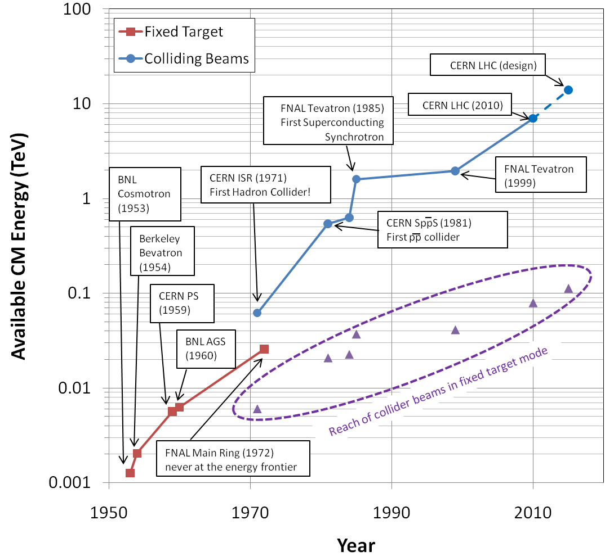
Evolution of the Energy Frontier
~a factor of 10 every 15 years

Slide 11
Luminosity
Rate
The relationship of the beam to the rate of observed physics processes is given by the “Luminosity”
Cross-section (“physics”)
“Luminosity”
Standard unit for Luminosity is cm⁻²s⁻¹ Standard unit of cross section is “barn”=10⁻²⁴ cm² Integrated luminosity is usually in barn⁻¹,where
nb⁻¹ = 10⁹ b⁻¹, fb⁻¹=10¹⁵ b⁻¹, etc
For (thin) fixed target:
Target thickness
Example: MiniBooNe primary target:
Incident rate
Target number density

Slide 12
Colliding Beam Luminosity
Circulating beams typically “bunched”
(number of interactions)
Cross-sectional area of beam
Total Luminosity:
Circumference of machine
Number of bunches
Record e+e- Luminosity (KEK-B): 2.11x10³⁴ cm⁻²s⁻¹ Record p-pBar Luminosity (Tevatron): 4.06x10³² cm⁻²s⁻¹ Record Hadronic Luminosity (LHC): 3.60x10³³ cm⁻²s⁻¹ LHC Design Luminosity: 1.00x10³⁴ cm⁻²s⁻¹

Slide 13
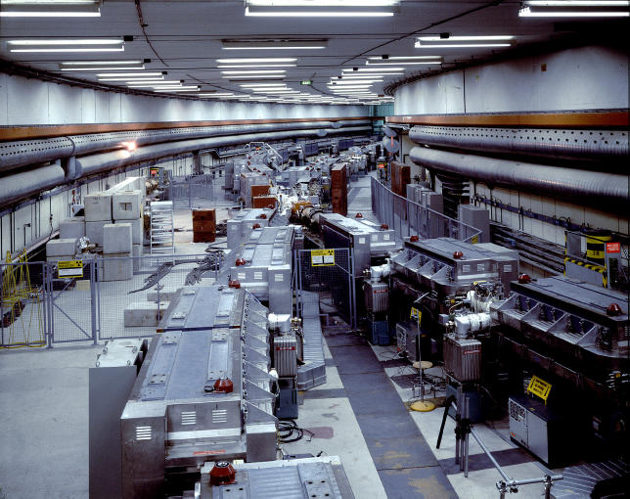
History: CERN Intersecting Storage Rings (ISR)
First hadron collider (p-p)
Highest CM Energy for 10 years
Until SppS
Reached it’s design luminosity within the first year.
Increased it by a factor of 28 over the next 10 years
Its peak luminosity in 1982 was 140x10³⁰ cm⁻²s⁻¹
a record that was not broken for 23 years!!

Slide 14
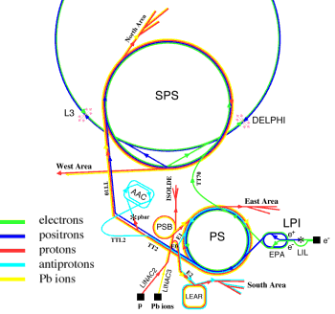
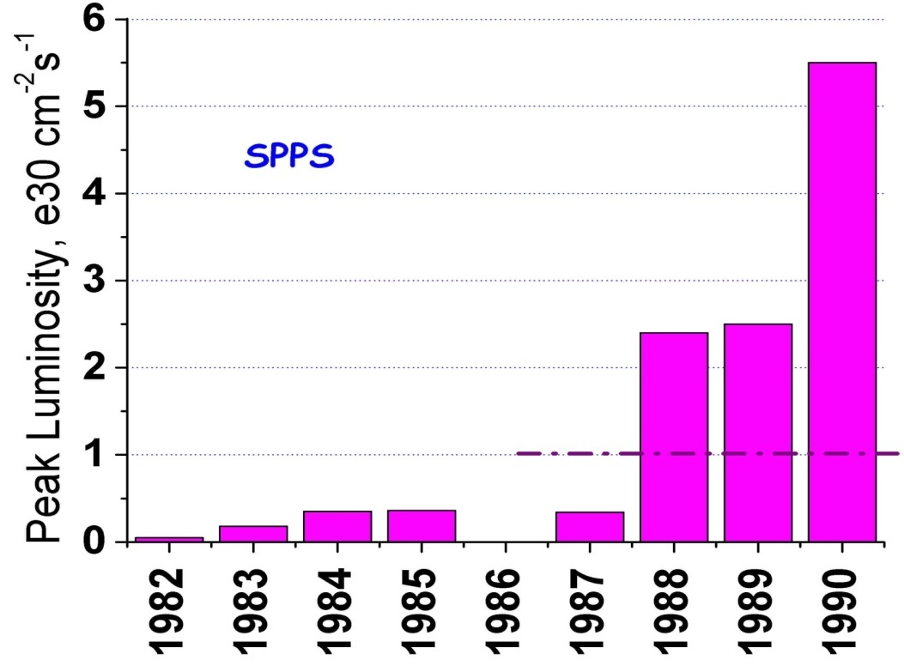
SppS: First proton-antiproton Collider
Protons from the SPS were used to produce antiprotons, which were collected
These were injected in the opposite direction and accelerated
First collisions in 1981
Discovery of W and Z in 1983
Nobel Prize for Rubbia and Van der Meer
Energy initially 270+270 GeV
Raised to 315+315 GeV
Limited by power loss in magnets!
Peak luminosity: 5.5x10³⁰cm⁻²s⁻¹
~.2% of current LHC
design

Slide 15
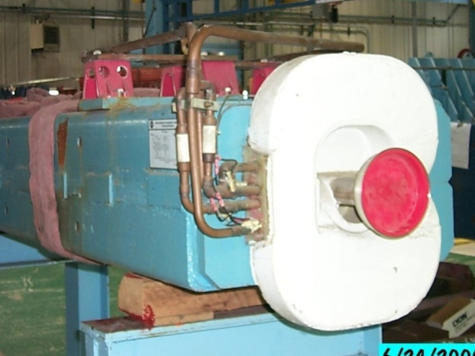
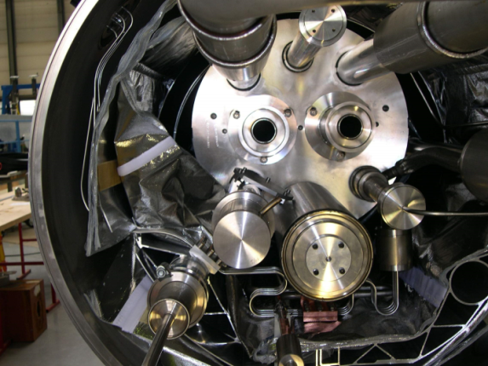
Superconductivity: Enabling Technology
The maximum SppS energy was limited by the maximum power loss that the conventional magnets could support in DC operation
P = I²R∝B²
Maximum practical DC field in conventional magnets ~1T
LHC made out of such magnets would be roughly the size of Rhode Island!
Highest energy colliders only possible using superconducting magnets
Must take the bad with the good
Conventional magnets are Superconducting magnets are simple and naturally dissipate complex and represent a great energy as they operate deal of stored energy which must be handled if something goes wrong

Slide 16
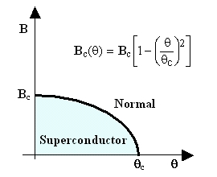
When is a superconductor not a superconductor?
Superconductor can change phase back to normal conductor by crossing the “critical surface”
When this happens, the conductor heats quickly, causing the surrounding conductor to go normal and dumping lots of heat into the liquid Helium⇒“quench
all of the energy stored in the magnet must be dissipated in some way
Dealing with quenches is the single biggest issue for any superconducting synchrotron!
Can push the B field (current) too high
Can increase the temp, through heat leaks, deposited energy or mechanical deformation
T_{c}

Slide 17

Quench Example: MRI Magnet*
*pulled off the web. We recover our Helium.

Slide 18
Milestones on the Road to a Superconducting Collider
1911 – superconductivity discovered by Heike Kamerlingh Onnes
1957 – superconductivity explained by Bardeen, Cooper, and Schrieffer
1972 Nobel Prize (the second for Bardeen!)
1962 – First commercially available superconducting wire
NbTi, the “industry standard” since
1978 – Construction began on ISABELLE, first superconducting collider (200 GeV+200 GeV) at Brookhaven.
1983, project cancelled due to design problems, budget overruns, and competition from…

Slide 19
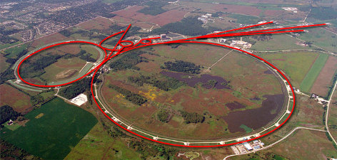
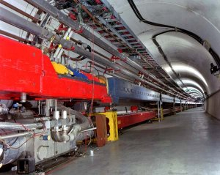
Fermilab: A brief history
1968 – Construction Begins
1972 – First 200 GeV beam in the Main Ring (400 GeV later that year)
Original director soon began to plan for a superconducting ring to share the tunnel with the Main Ring
Dubbed “Saver Doubler” (later “Tevatron”)
1982 – Magnet installation complete
1985 – First proton-antiproton collisions observed at CDF (1.6 TeV CoM). Most powerful accelerator in the world for the next quarter century
Late 1990’s – major upgrades to increase luminosity, including separate ring (Main Injector) to replace Main Ring
Main Ring
Tevatron

Slide 20
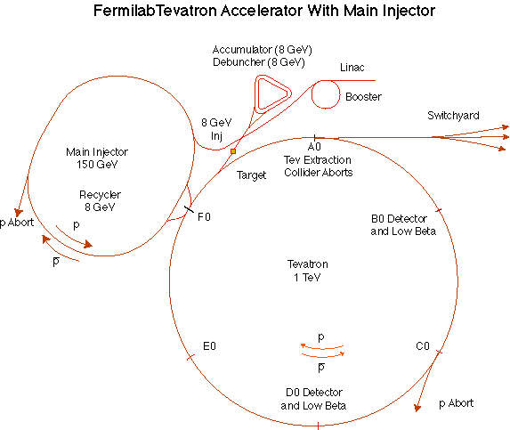
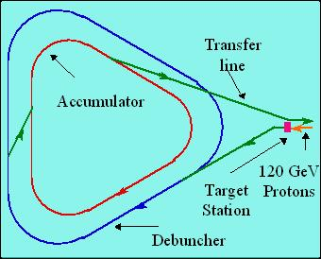
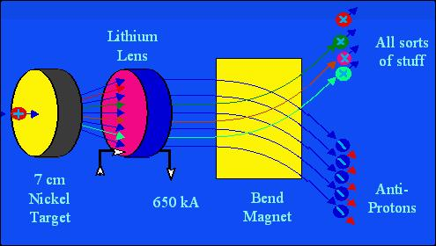
Production and Storage of Antiprotons
The antiproton ring consists of 2 parts – the Debuncher (trades ΔE for Δt) – the Accumulator (stores and cools)
Takes about one day to make ~3x10¹² antiprotons to inject and accelerate in Tevatron.
These collide while we make more
“stack and store” cycle
120 GeV protons strike a target, producing many things, including antiprotons.
a Lithium lens focuses these particles (a bit)
a bend magnet selects the negative particles around 8 GeV. Everything but antiprotons decays away.

Slide 21
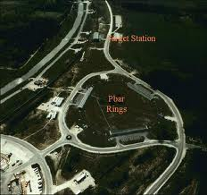
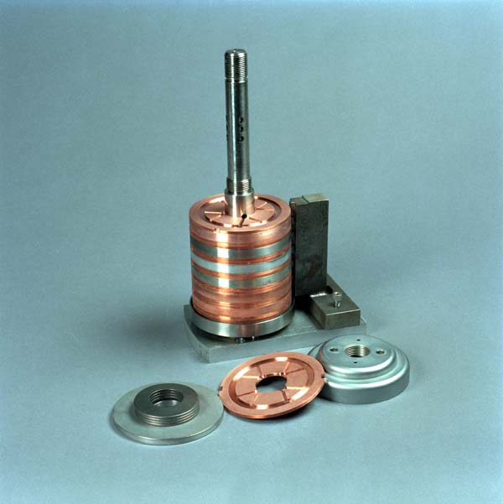
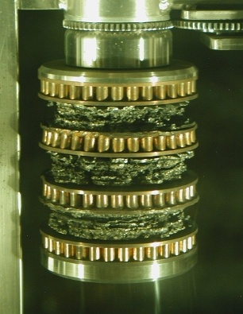
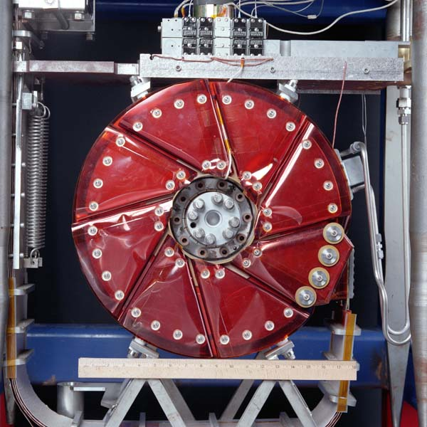
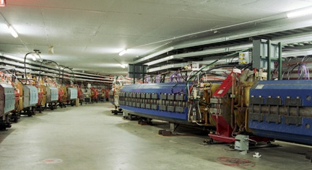
pBar in Pictures
From Above
Production Target
Before
After
Lithium Lens
In Tunnel
Debuncher
Accumulator

Slide 22
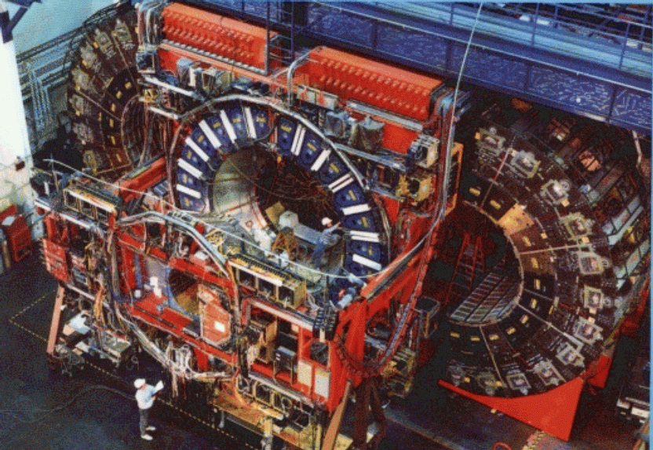
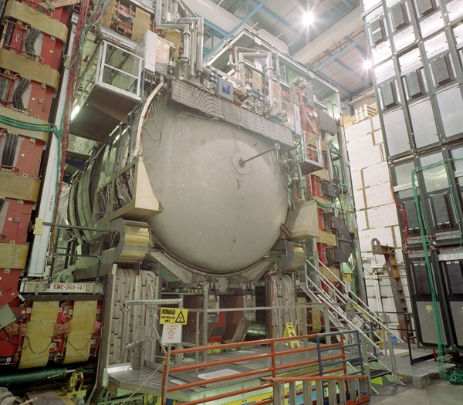
Experiments at the Tevatron
CDF (Collider Detector at Fermilab)
D0 (named for interaction point)
540 authors
15 countries
535 papers
500 PhD
550 authors
18 countries
(as of 2009)
>250 papers
>250 PhD students

Slide 23
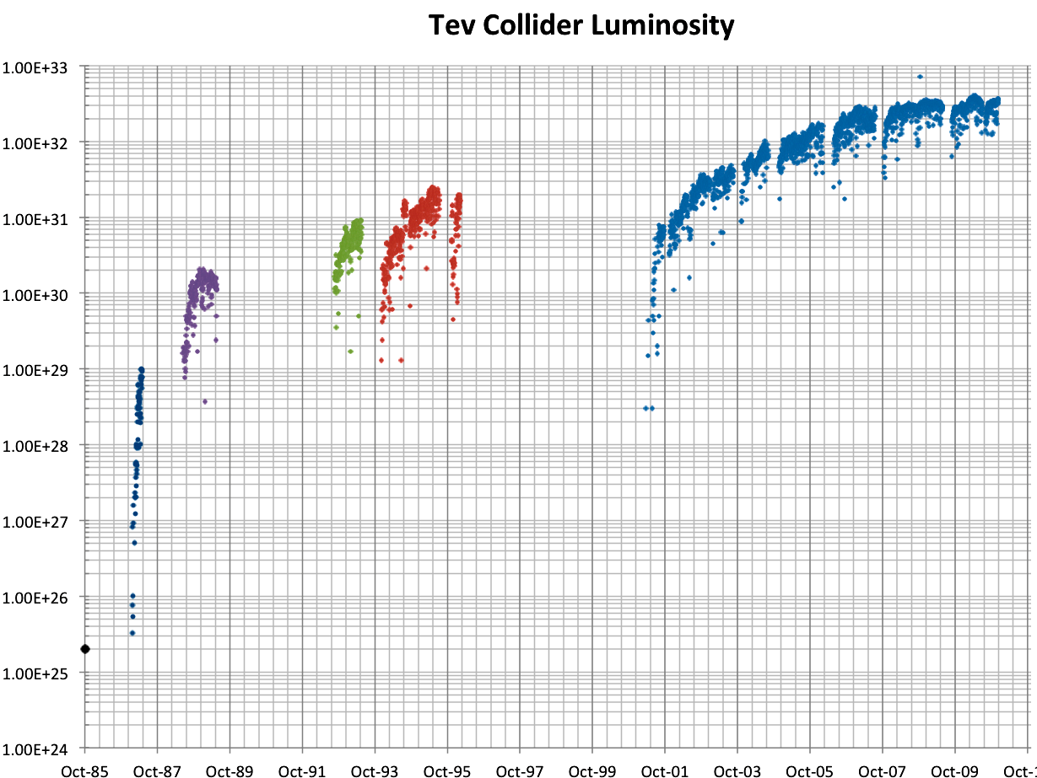
History of Fermilab Luminosity
ISR (pp) record
Original Run II Goal
SppS record
Run 1a
Run 1b
Run II
Run 0
Main Injector Construction
Discovery of top quark (1995)
87 Run

Slide 24
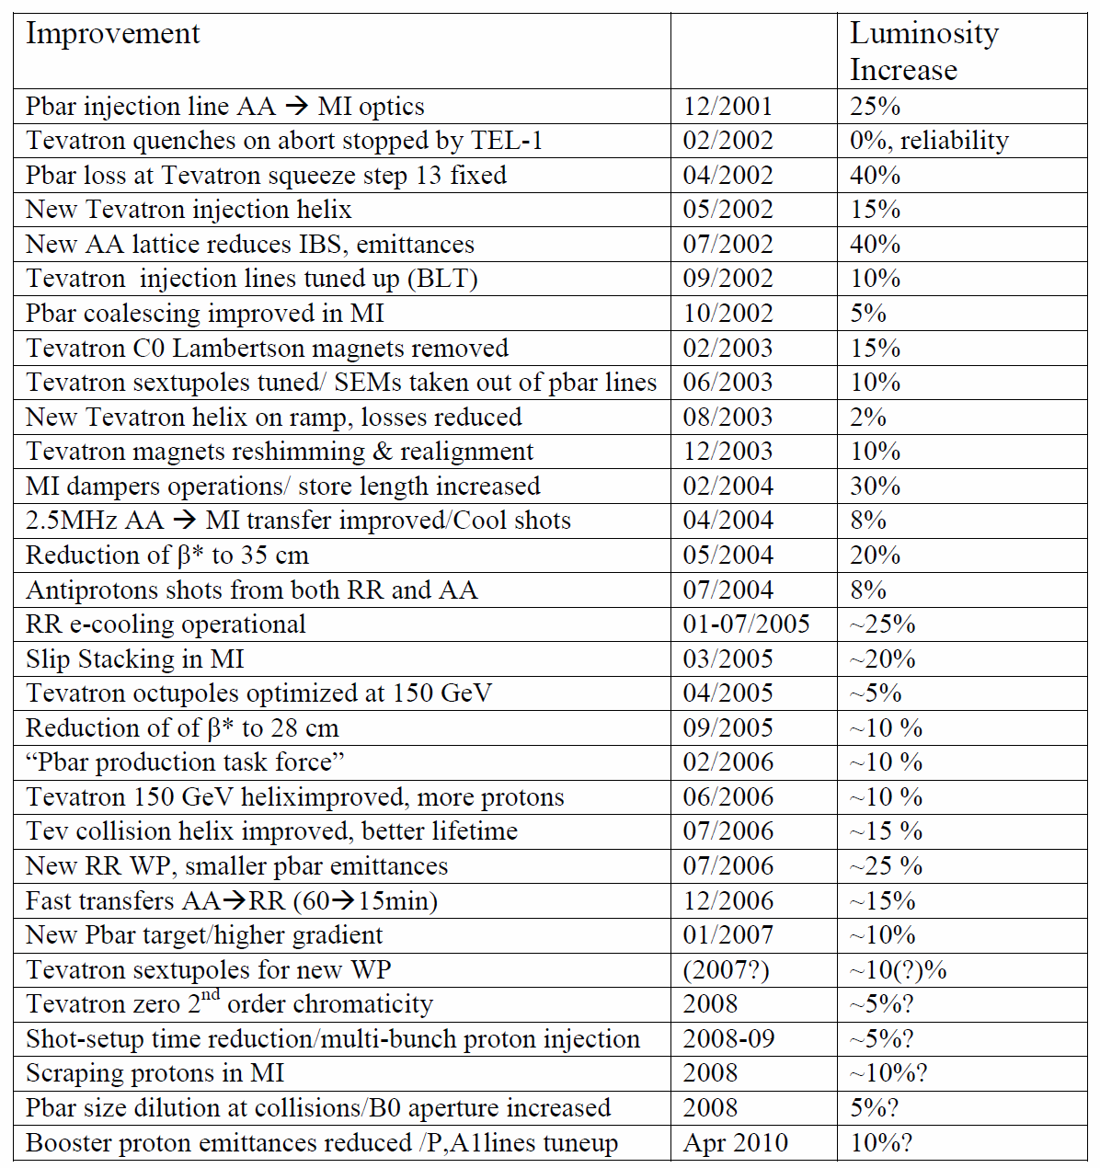
Run II: The road to peak luminosity
Some 30 steps, no “silver bullet”
Overall factor of 30 luminosity increase
24

Slide 25
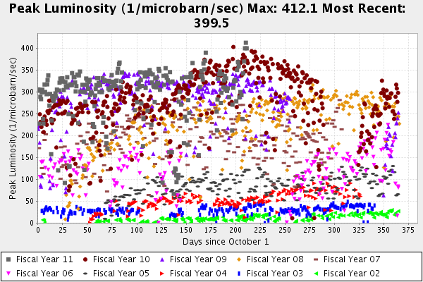
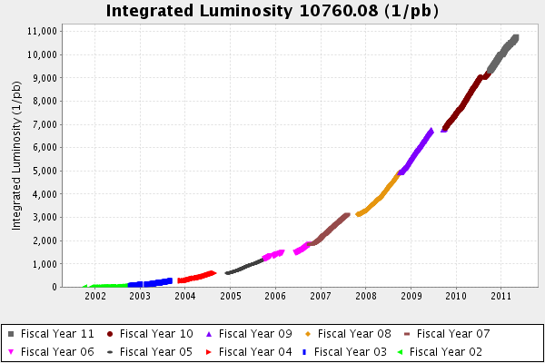
Tevatron End Game
The Tevatron integrated over ~10 fb⁻¹ per experiment
It set a p-pbar luminosity record
4.05x10³² cm⁻²s⁻¹
However, as there were no plans to increase the peak luminosity, the doubling time would be 3-5 years
Tevatron turned off permanently on September 29^{th,} 2011, in light of successful startup of LHC…

Slide 26
CERN: A brief history
1951 –The “Conseil Européen pour la Recherche Nucléaire” (CERN) established in a UNSESCO resolution proposed by I.I. Rabi to “establish a regional laboratory”
Geneva (+ a bit of France) chosen as site.
1957 – first accelerator operation (600 MeV synchro-cyclotron)
1959 – 28 GeV proton synchrotron (PS) cements the tradition of extremely unimaginative acronyms
PS (and acronym policy) still in use today!
1971 – Intersecting Storage Rings (ISR) – first proton-proton collider
1983 – SppS becomes first proton-antiproton collider
Discovers W+Z particles: 1984 Nobel Prize for Rubbia and van der Meer
1989 – 27 km Large Electron Positron (LEP) collider begins operation at CM energy of 90 GeV (Z mass)
Unprecedented tests of Standard Model
1990 – Tim Berners-Lee invents the World Wide Web
2000 – Dan Brown writes “Angels and Demons” (There’s no such thing as bad publicity!).

Slide 27
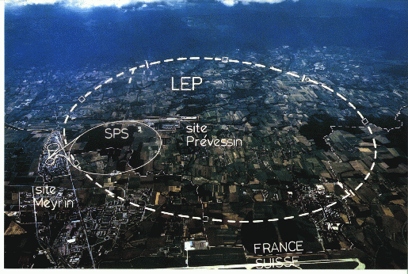
LHC: Location, Location, Location…
My House (1990-1992)
/LHC
Tunnel originally dug for LEP
Built in 1980’s as an electron positron collider
Max 100 GeV/beam, but 27 km in circumference!!

Slide 28
Partial LHC Timeline
1994:
The CERN Council formally approves the LHC
1995:
LHC Technical Design Report
2000:
LEP completes its final run
First dipole delivered
2005
Civil engineering complete (CMS cavern)
First dipole lowered into tunnel
2007
Last magnet delivered
First sector cold
All interconnections completed
2008
Accelerator complete
Last public access
Ring cold and under vacuum

Slide 29
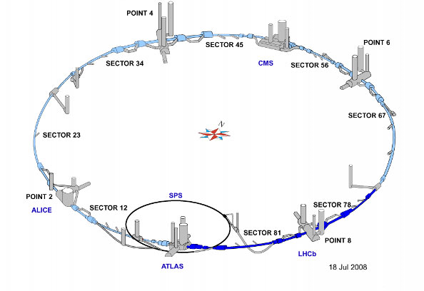
LHC Layout
8 crossing interaction points (IP’s)
Accelerator sectors labeled by which points they go between
ie, sector 3-4 goes from point 3 to point 4

Slide 30
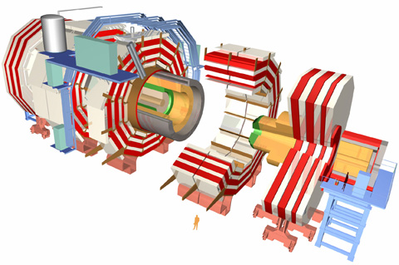
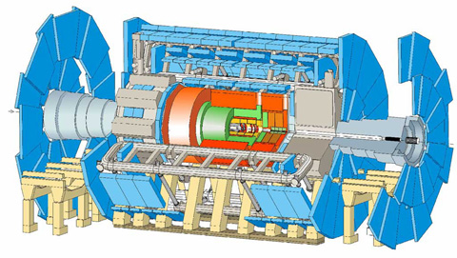
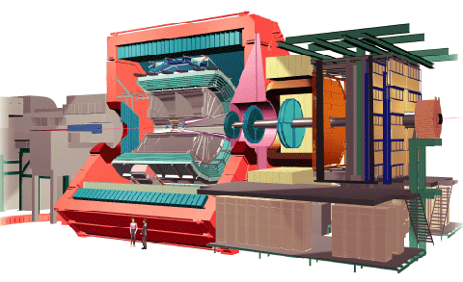
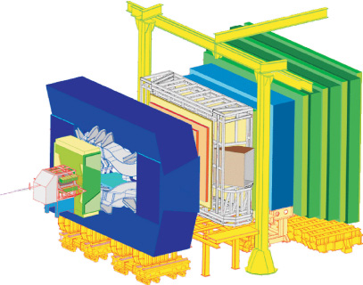
LHC Experiments
Huge, general purpose experiments:
“Medium” special purpose experiments:
Compact Muon Solenoid (CMS)
A Toroidal LHC ApparatuS (ATLAS)
A Large Ion Collider Experiment (ALICE)
B physics at the LHC (LHCb)

Slide 31
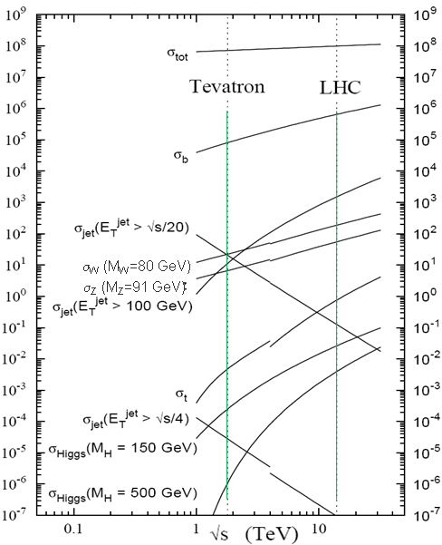
Nominal LHC Parameters Compared to Tevatron
Parameter | Tevatron | “nominal” LHC
Circumference | 6.28 km (2*PI) | 27 km
Beam Energy | 980 GeV | 7 TeV
Number of bunches | 36 | 2808
Protons/bunch | 275x10⁹ | 115x10⁹
pBar/bunch | 80x10⁹ | -
Stored beam energy | 1.6 + .5 MJ | 366+366 MJ*
Magnet stored energy | 400 MJ | 10 GJ
Peak luminosity | 3.3x10³² cm⁻²s⁻¹ | 1.0x10³⁴ cm⁻²s⁻¹
Main Dipoles | 780 | 1232
Bend Field | 4.2 T | 8.3 T
Main Quadrupoles | ~200 | ~600
Operating temperature | 4.2 K (liquid He) | 1.9K (superfluid He)
Increase in cross section of up to 5 orders of magnitude for some physics processes
*Each beam = TVG@150 km/hr ⇒ very scary numbers
1.0x10³⁴ cm⁻²s⁻¹ ~ 50 fb⁻¹/yr= ~5 x total TeV data

Slide 32
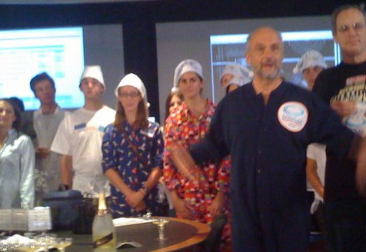
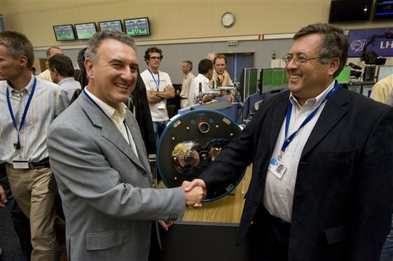
Initial Startup and “Incident”
Note: because of a known problem with magnet de-training, initial operation was always limited to 5 TeV/beam
On September 10, 2008 a worldwide media event was planned for the of the LHC
9:35 CET: First beam injected
10:26 CET: First full turn (<1 hour)
Commissioning was proceeding very smoothly, until…
September 19th, sector 3-4 was being ramped (without beam) to the equivalent of 5.5 TeV for the first time
All other sectors had been commissioned to this field prior to start up
A quench developed in a superconducting interconnect
The resulting arc burned through the beam pipe and Helium transport lines, causing Helium to boil and rupture into the insulation vacuum

Slide 33
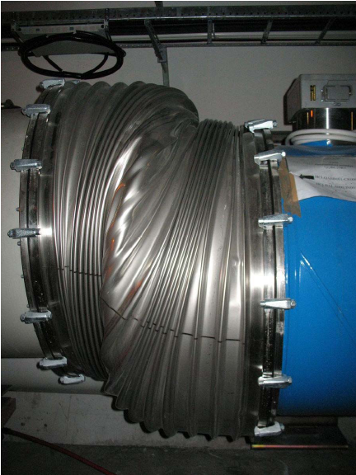
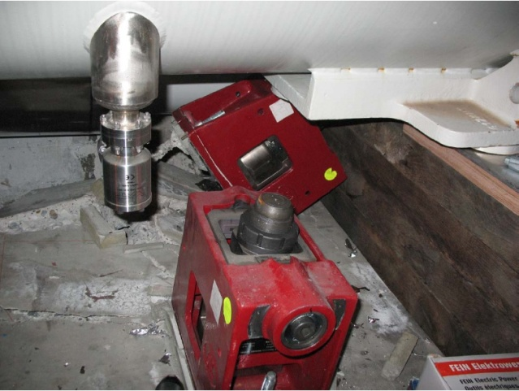
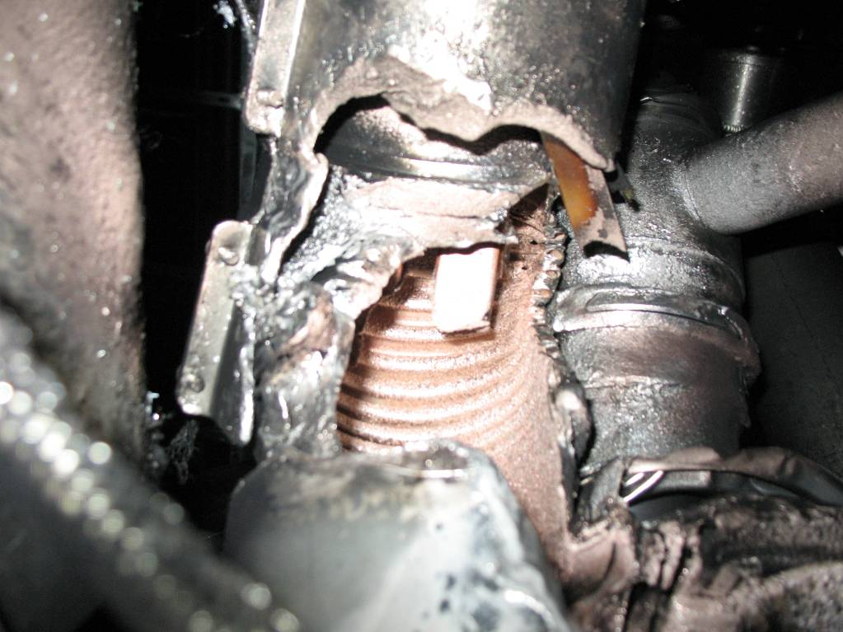
Collateral Damage from Incident
At the subsector boundary, pressure was transferred to the cold mass and magnet stands
Debris in beam vacuum pipe
Secondary arcs
Clean
Insulation
Soot

Slide 34
Issues and Improvements
Bad joints
Test for high resistance and look for signatures of heat loss in joints
Warm up to repair any with signs of problems (additional three sectors)
Quench protection
Old system sensitive to 1V
New system sensitive to .3 mV (factor >3000)
Pressure relief
Warm sectors (4 out of 8)
Install 200mm relief flanges
Enough capacity to handle even the maximum credible incident (MCI)
Cold sectors
Reconfigure service flanges as relief flanges
Reinforce floor mounts
Enough to handle what happened, but not worst case
Beam re-started on November 20, 2009
Still limited to 3.5 TeV/beam until joints fully repaired/rebuilt
Commissioning began…

Slide 35
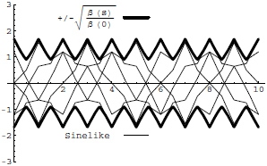
Digression: All the Beam Physics U Need 2 Know
Transverse beam size is given by
Betatron function: envelope determined by optics of machine
Trajectories over multiple turns
Note: emittance shrinks with increasing beam energy ⇒”normalized emittance”
Emittance: area of the ensemble of particle in phase space
Area = ε
Usual relativistic β & γ

Slide 36
Collider Luminosity
For identical, Gaussian colliding beams, luminosity is given by
Revolution frequency
Number of bunches
Bunch size
Betatron function at collision point
Transverse beam size
Normalized beam emittance
Geometric factor, related to crossing angle.

Slide 37
Limits to β*
β
β distortion of off-momentum particles ∝ 1/β* (affects collimation)
s
⇒ small β* means large β (aperture) at focusing triplet

Slide 38
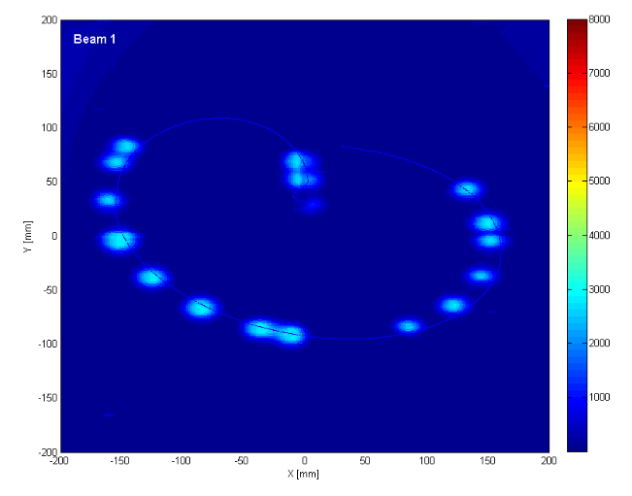
General Commissioning Plan
Push bunch intensity
Achieved nominal bunch intensity of >1.1x10¹¹ much faster than anticipated.
Remember: L∝N_{b}²
Rules out many potential accelerator problems
Increase number of bunches
Go from single bunches to “bunch trains”, with gradually reduced spacing.
At all points, must carefully verify
Beam collimation
Beam protection
Beam abort
Remember:
TeV=1 week for cold repair
LHC=3 months for cold repair
Example: beam sweeping over abort

Slide 39
Significant Milestones
Sunday, November 29th, 2009:
Both beams accelerated to 1.18 TeV simultaneously
LHC Highest Energy Accelerator
Monday, December 14th , 2009
Stable 2x2 at 1.18 TeV
Collisions in all four experiments
LHC Highest Energy Collider
Tuesday, March 30th, 2010
Collisions at 3.5+3.5 TeV
LHC Reaches target energy for 2010-2012
Friday, April 22nd, 2011
Luminosity reaches 4.67x10³² cm⁻²s⁻¹
LHC Highest luminosity hadron collider in the world

Slide 40
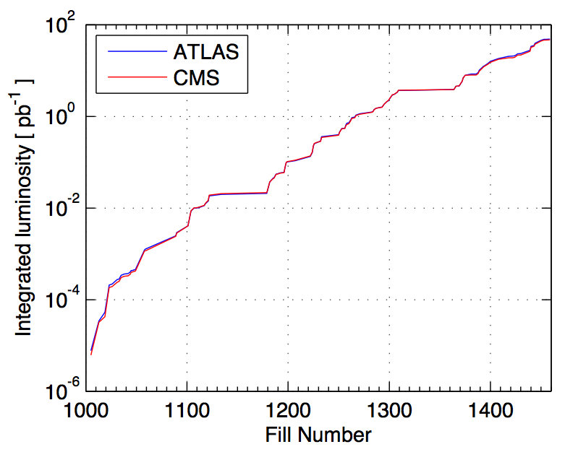
2010 Performance*
Performance ramp-up (368 bunches)
Nominal bunch operation (up to 48)
Bunch trains
Initial luminosity run
Nominal bunch commissioning
*From presentation by DG to CERN staff

Slide 41
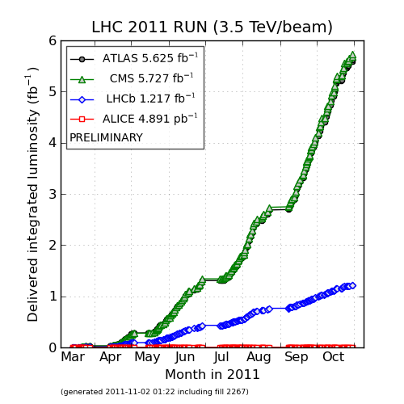
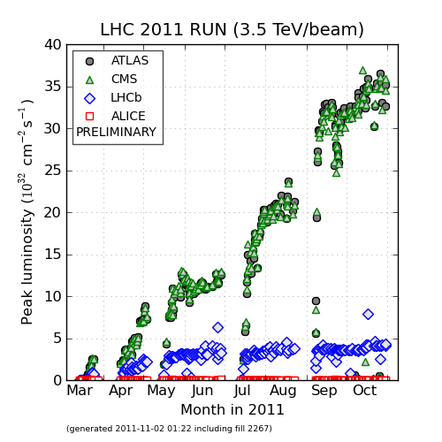
2011 Performance
Tevatron Record
Peak Luminosity:
~3.6x10³³ cm⁻²s⁻¹ (36% of nominal)
Integrated Luminosity:
~6.7 fb⁻¹/experiment

Slide 42
Near Term Plan
Switch now to ion running
Pb-Pb and Pb-p
Accumulate luminosity at 3.5 TeV+3.5 TeV in 2012
Beams bigger at this energy, so luminosity limit ~5x1033 cm-2s-1
Shut down for ~15 months starting in 2013
Repair joint problem
Open all junctions to resolder and clamp ~10,000 joints!
Miscellaneous collimation improvements
This will enable running at the 7 TeV+ 7 TeV design energy.

Slide 43
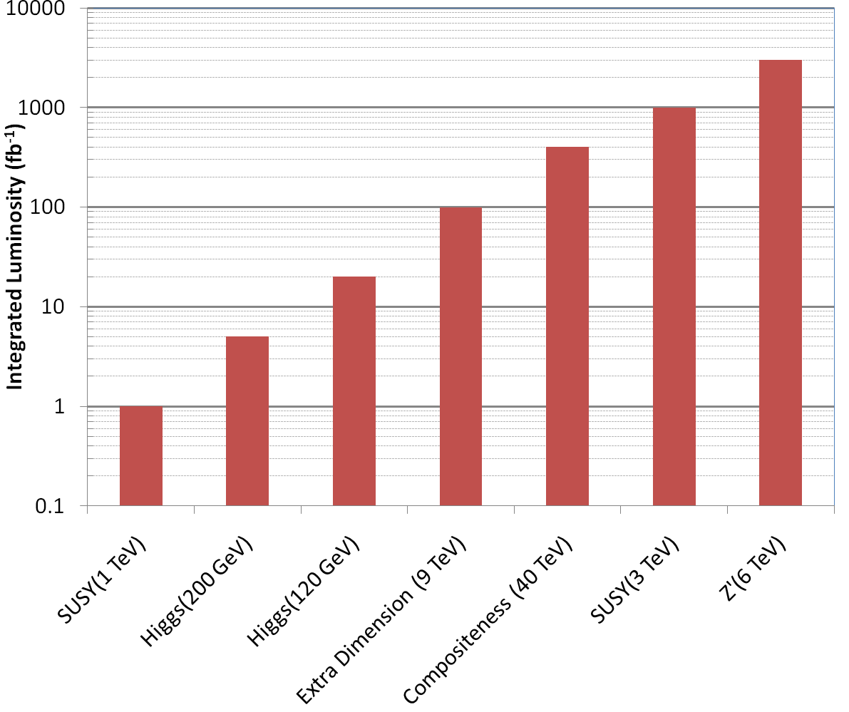
Nice Work, but…
3000 fb⁻¹
~150 years at present luminosity
~50 years at design luminosity
The future begins now

Slide 44
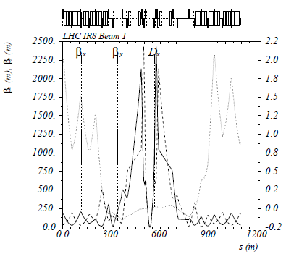
The Case for New Quadupoles
High Luminosity LHC Proposal: β*=55 cm ⇒ β*=10 cm
Just like classical optics
Small, intense focus ⇒ big, powerful lens
Small β*⇒huge β at focusing quad
Need bigger quads to go to smaller β*
Existing quads
70 mm aperture
200 T/m gradient
Proposed for upgrade
At least 120 mm aperture
200 T/m gradient
Field 70% higher at pole face
Beyond the limit of NbTi
Must go to Nb₃Sn (LARP)

Slide 45
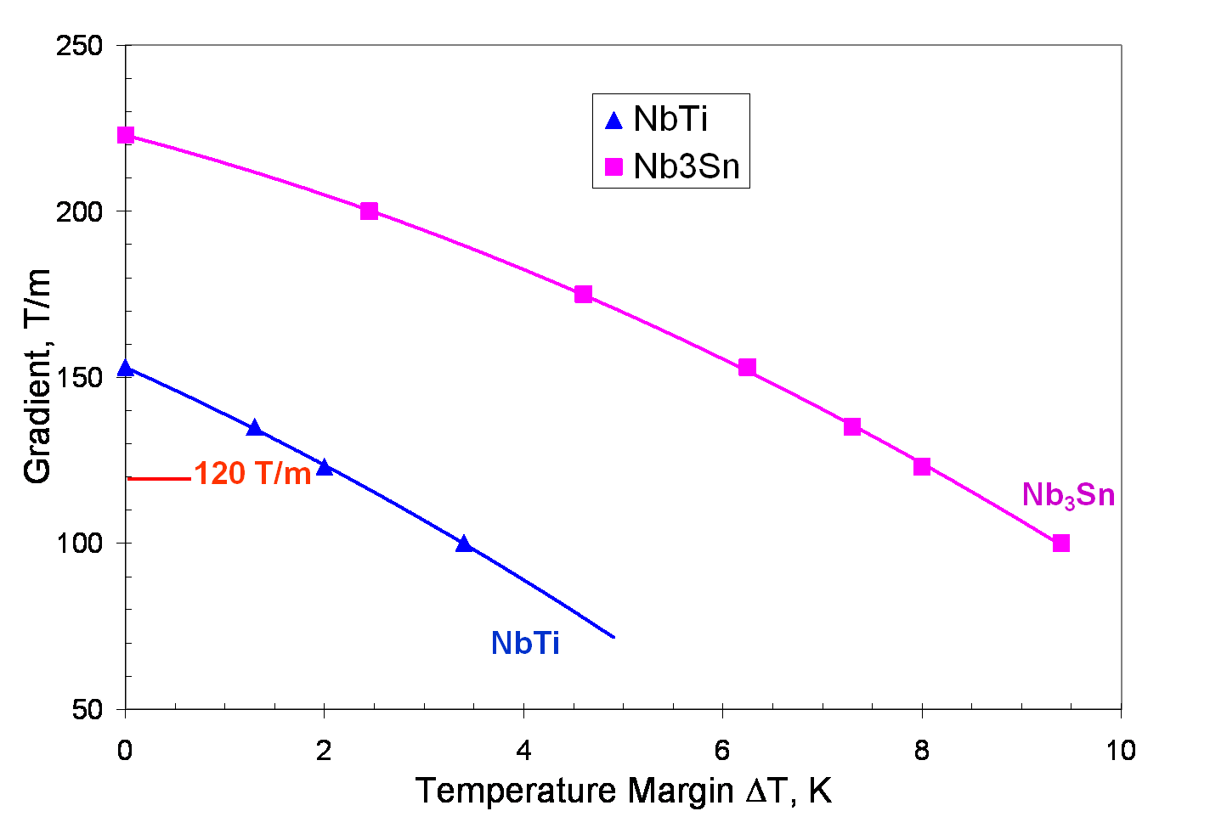
Motivation for Nb₃Sn
Nb₃Sn can be used to increase aperture/gradient and/or increase heat load margin, relative to NbTi
Limit of NbTi magnets
Very attractive, but no one has ever built accelerator quality magnets out of Nb₃Sn
Whereas NbTi remains pliable in its superconducting state, Nb₃Sn must be reacted at high temperature, causing it to become brittle
Must wind coil on a mandrel
React
Carefully transfer to magnet
120 mm aperture

Slide 46
Long Term Plan (after 2013 shutdown)
Increase energy to 7 TeV/beam (or close to it)
Increase luminosity to nominal 1x10³⁴ cm⁻²s⁻¹
Run!
Shut down in ~2016
Tie in new LINAC
Increase Booster energy 1.4->2.0 GeV
Finalize collimation system (LHC collimation is a talk in itself)
Shut down in ~2021
Full luminosity: >5x10³⁴ leveled
New inner triplets based on Nb₃Sn
Smaller β means must compensate for crossing angle
Crab cavities base line option
Other solutions considered as backup
If everything goes well, could reach 3000 fb⁻¹ by 2030

Slide 47
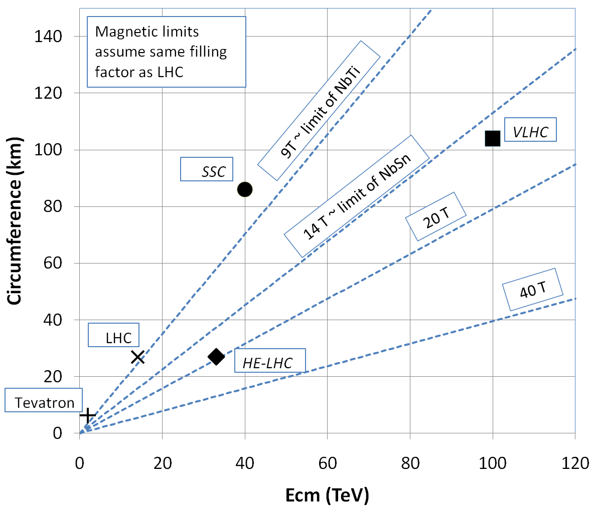
What next?
The energy of Hadron colliders is limited by feasible size and magnet technology. Options:
Get very large (eg, VLHC > 100 km circumference)
More powerful magnets (requires new technology)
In October 2010, a workshop was organized to discuss the potential to build a higher energy synchrotron in the existing LHC tunnel.
Nominal specification
Energy: 16.5+16.5 TeV
Luminosity: at least 2x10³⁴ cm⁻²s⁻¹
Construction to begin: ~2030
This is beyond the limit of NbTi magnets
Must utilize alternative superconductors

Slide 48
Superconductor Options
Traditional
NbTi
Basis of ALL superconducting accelerator magnets to date
Largest practical field ~8T
Nb₃Sn
Advanced R&D
Being developed for large aperture/high gradient quadrupoles
Larges practical field ~14T
High Temperature
Industry is interested in operating HTS at moderate fields at LN₂ temperatures. We’re interested in operating them at high fields at LHe temperatures.
MnB₂
promising for power transmission
can’t support magnetic field.
YBCO
very high field at LHe
no cable (only tape)
BSCCO (2212)
strands demonstrated
unmeasureably high field at LHe
Focusing on this, but very expensive
⇒ pursue hybrid design

Slide 49
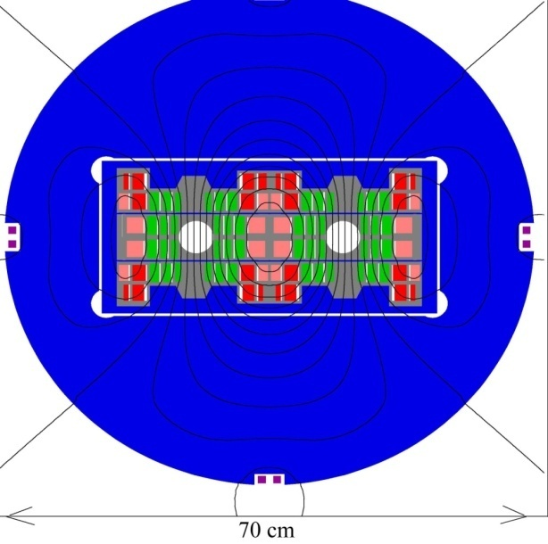
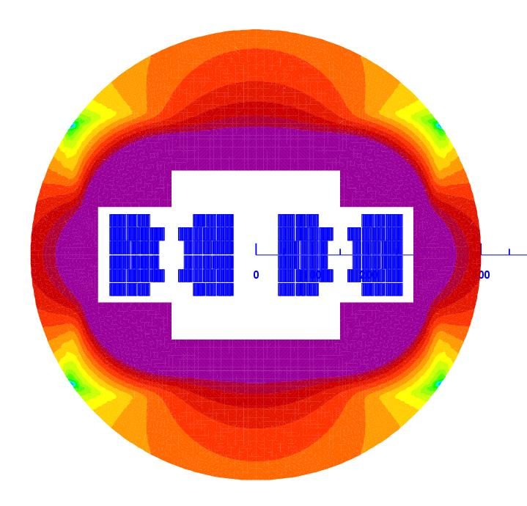
Potential Designs
P. McIntyre 2005 – 24T ss Tripler, a lot of Bi-2212 , Je = 800 A/mm2
E. Todesco 2010
20 T, 80% ss
30% NbTi
55 %NbSn
15 %HTS
All Je < 400 A/mm2

Slide 50
Other Paths to the Energy Frontier
Leptons vs. Hadrons revisited
Because 100% of the beam energy is available to the reaction, a lepton collider is competitive with a hadron collider of ~5-10 times the beam energy (depending on the physics).
A lepton collider of >1 TeV/beam could compete with the discovery potential of the LHC
A lower energy lepton collider could be very useful for precision tests, but I’m talking about direct energy frontier discoveries.
Unfortunately, building such a collider is VERY, VERY hard
Eventually, circular e⁺e⁻ colliders will radiate away all of their energy each turn
LEP reached 100 GeV/beam with a 27 km circuference synchrotron!
⇒ Next e⁺e⁻ collider will be linear

Slide 51
International Linear Collider (ILC)
LEP was the limit of circular e⁺e⁻ colliders
Next step must be linear collider
Proposed ILC 30 km long, 250 x 250 GeV e⁺e⁻ (NOT energy frontier)
We don’t yet know whether that’s high enough energy to be interesting
Need to wait for LHC results
What if we need more?

Slide 52
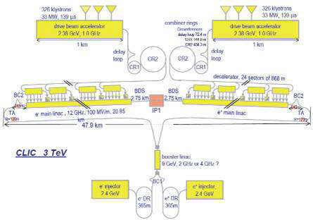
“Compact” (ha ha) Linear Collider (CLIC)?
Use low energy, high current electron beams to drive high energy accelerating structures
Up to 1.5 x 1.5 TeV, but VERY, VERY hard

Slide 53

Muon colliders?
Muons are pointlike, like electrons, but because they’re heavier, synchrotron radiation is much less of a problem.
Unfortunately, muons are unstable, so you have to produce them, cool them, and collide them, before they decay.

Slide 54

Wakefield accelerators?
Many advances have been made in exploiting the huge fields that are produced in plasma oscillations.
Potential for accelerating gradients many orders of magnitude beyond RF cavities.
Still a long way to go for a practical accelerator.

Slide 55
Summary and Conclusion
The quest for the highest energy has driven accelerator science since the very beginning.
After an unprecedented quarter century reign, the Tevatron has been superceded by LHC as the world’s energy frontier machine.
The startup of the LHC has been remarkably smooth
for the most part!
It will likely be the worlds premiere discovery machine for some time to come.
Nevertheless, given the complexity of the next steps
Luminosity
Energy
there’s no time to rest
The future starts now!!

Slide 56
Acknowlegments
Since this is a summary talk, it would be impossible to list all of the people who have contributed to it.
Let’s just say at least everyone at CERN and Fermilab, past and present…
…and some other people, too.

Slide 57
BACKUP SLIDES

Slide 58

The (side) Road to Higher Energy
1980’s - US begins planning in earnest for a 20 TeV+20 TeV “Superconducting Super Collider” or (SSC).
87 km in circumference!
Considered superior to the “Large Hadron Collider” (LHC) then being proposed by CERN.
1987 – site chosen near Dallas, TX
1989 – construction begins
1993 – amidst cost overruns and the end of the Cold War, the SSC is canceled after 17 shafts and 22.5 km of tunnel had been dug.

Slide 59
Limits to Tevatron Luminosity
Tevatron luminosity has always been primarily limited by availability of antiprotons
In “stack and store” cycle, 120 GeV protons are used to produce antiprotons, which are collected in the Accumulator/Debuncher system.
After about a day, there are enough antiprotons to inject into the Tevatron, to be accelerated and put into collisions with protons in the other direction.
These collisions continue while more antiprotons are produced.
Initially, the production and antiprotons and intermediate acceleration were done with the original Main Ring, which still shared the tunnel with the Tevatron.
The biggest single upgrade has been the advent of the Main Injector, a separate accelerator to take over these tasks⇒”Run II”

Slide 60

Run II: Main Injector/Recycler
The Main Injector
Replaced the Main Ring as the source of 120 GeV Protons for production of antiprotons
Accelerates protons and antiprotons to 150 GeV for injection into the Tevatron
Also serves 120 GeV neutrino and fixed target programs
The Recycler
8 GeV storage ring made of permanent magnets
Used to store large numbers of antiprotons from the Accumulator prior to injection into the Tevatron

Slide 61


Operation of Debuncher/Accumulator
Protons are accelerated to 120 GeV in Main Injector and extracted to pBar target
pBars are collected and phase rotated in the “Debuncher”
Transferred to the “Accumulator”, where they are cooled and stacked

Slide 62

Problems out of the Gate
Magnet de-training
ALL magnets were “trained” to achieve 7+ TeV.
After being installed in the tunnel, it was discovered that the magnets supplied by one of the three vendors “forgot” their training.
Symmetric Quenches
The original LHC quench protection system was insensitive to quenches that affected both apertures simultaneously.
While this seldom happens in a primary quench, it turns out to be common when a quench propagates from one magnet to the next.
1st Training quench above ground
1st quench in tunnel
For these reasons, the initial energy target was reduced to 5+5 TeV well before the start of the 2008 run.

Slide 63
Limits to LHC Luminosity*
Rearranging standard terms a bit…
Total beam current. Limited by:
Uncontrolled beam loss!
E-cloud and other instabilities
Brightness, limited by
Injector chain
Max. beam-beam
If n_{b}>156, must turn on crossing angle…
β at IP, limited by
magnet technology
chromatic effects
…which reduces this
*see, eg, F. Zimmermann, “CERN Upgrade Plans”, EPS-HEP 09, Krakow

Slide 64

Getting to 7 TeV*
Note, at high field, max 2-3 quenches/day/sector
Sectors can be done in parallel/day/sector (can be done in parallel)
No decision yet, but it will be a while
*my summary of data from A. Verveij, talk at Chamonix, Jan. 2009

Slide 65

Superconductor Summary
NbTi=basis of ALL SC accelerators magnets to date
The future?
J_{e} floor for practicality
Nb₃Sn=next generation
*Peter Lee (FSU)

